Slide 1
Cinema App Presentation
Team member:
14432417 Wenxuan Wang
24937524 Ming Zhang
14285353 Dongqi Han

Slide 2
Target Audience
Cinema or entertainment venue staff and managers
Individuals interested in film ticketing systems and seat reservations

Slide 3
Problem Solved
Main problem - Ticket booking Complexity
Solutions:
Efficient film ticket booking, checking film information, availability of film ticket.
Seat selection management become easier while using the app.
Provide better User experience.
Other/existing possible solutions:
Traditional cinema website / APP (Complex booking process, may fill in customer information multiple times)
On-site ticket booking (May result in limited or undesirable seating, not suitable for popular movies or busy times)
Phone reservation (potential wait times, not ideal for quick reservations)

Slide 4
Demo

Slide 5
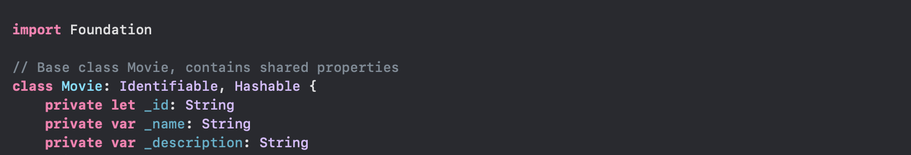
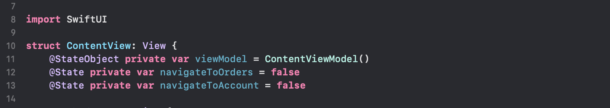
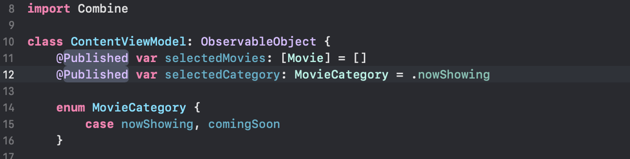
Frameworks/Services used in App
Frameworks and Services:
Swift UI
Combine
Foundation
Advantages:
Declarative UI
Reactive Programming
Strong Data Handling
Limitations:
Steeper Learning Curve for SwiftUI
Combine Complexity
iOS Exclusive
Model
View
ViewModel

Slide 6
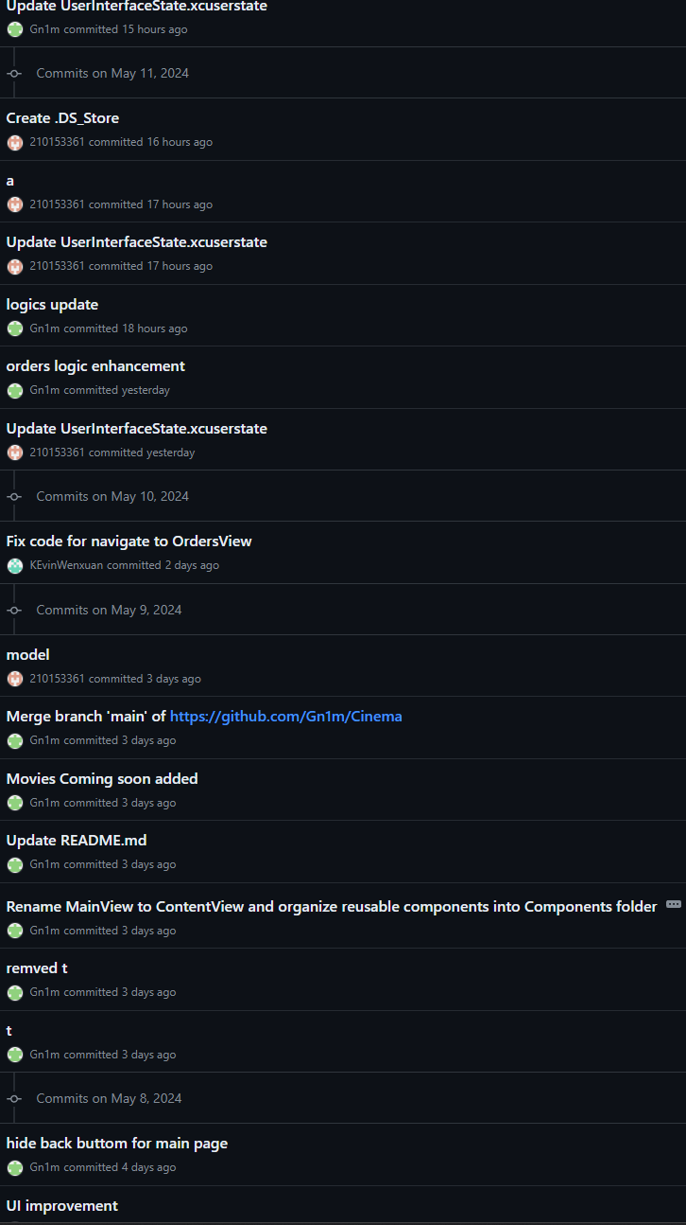
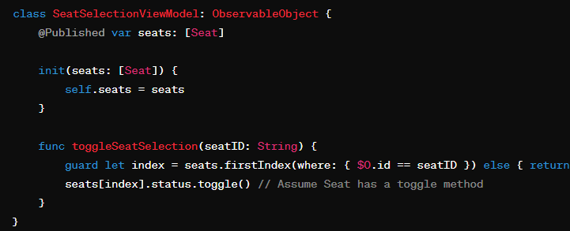
Greatest Difficulty
Challenge:
Synchronize seat availability in real-time across all views.
Solution:
Use ObservableObject to manage state.
Implement real-time data refresh with code examples.
Outcome:
Increased app reliability and user satisfaction

Slide 7
Compares To Others
2D Seat Selection
App easier to navigate
Quicker booking process
Easier order/ cancellation system

Slide 8
Iterative Product Design Cycle to achieve MVP
User Interactions
Competitor Analysis
Select the most critical features such as, movie selection, seat booking and user account.
Make necessary adjustments to the app based on user feedback.

